Slide 1

Presentation on “Garbage Detection using Machine Learning, Edge AI & Drone” M.Tech Embedded Systems Electronics and Communication April 2025 Subject : Machine Learning For Embedded System
Presented To : Prepared By :
Prof. Ruchi Gajjar Samir Khanusiya [24MRE007]

Slide 2
Introduction
The world is facing a growing problem of unmanaged waste.
Municipal authorities con monitor garbage accumulation in streets, and public spaces.
Traditional garbage collection systems are inefficient and rely heavily on manual labor.
AI and drones offer a scalable, real-time solution for identifying and managing garbage in urban and rural areas.

Slide 3
Objectives
Build a machine learning model to detect garbage
- Use Robo flow for image annotation and dataset preparation
- Train the model using Google Colab
- Deploy the model on Raspberry Pi for edge detection
- Integrate the setup with a drone for aerial surveillance

Slide 4
System Overview
The project follows a modular approach:
Using Robo flow
1. Dataset Collection & Annotation: Roboflow
2. Model Training: YOLOv5 on Google Colab
3. Deployment: Raspberry Pi as Edge Device
4. Integration: Mounted on Drone for Real-time Aerial Detection

Slide 5
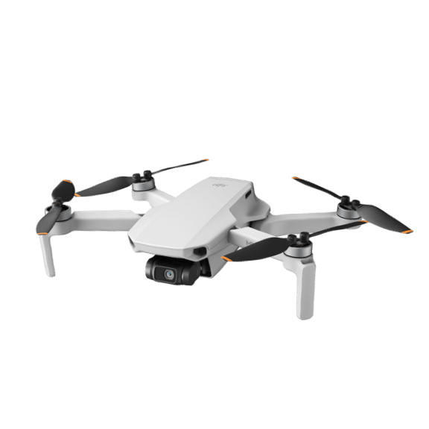
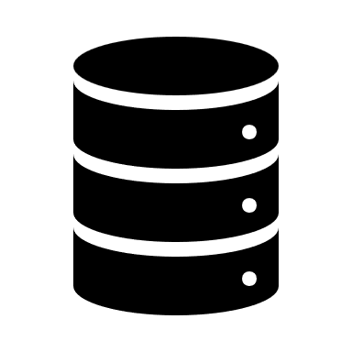
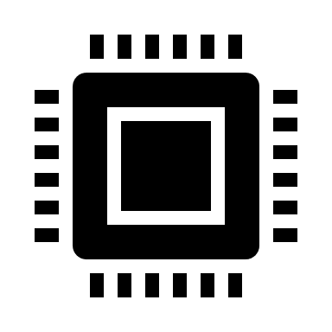
Flow
RTMP server
DJI Mini 2
Edge device

Slide 6


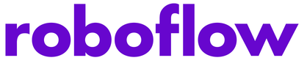
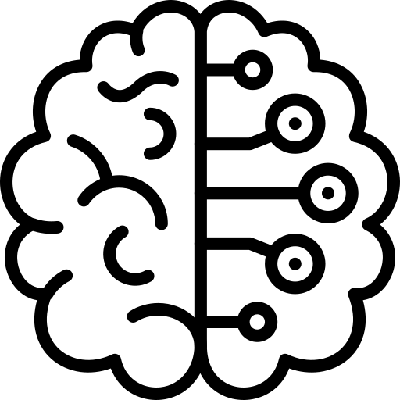


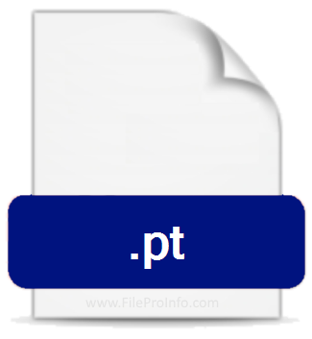
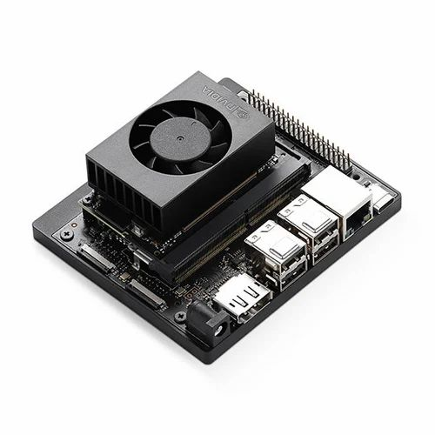

Training Flow
Data Set Creation
Data Set Annotation
Data Set Augmentation
Data Acquisition
Training Model
Inference on Hardware
Nvidia Jetson Orin

Slide 7
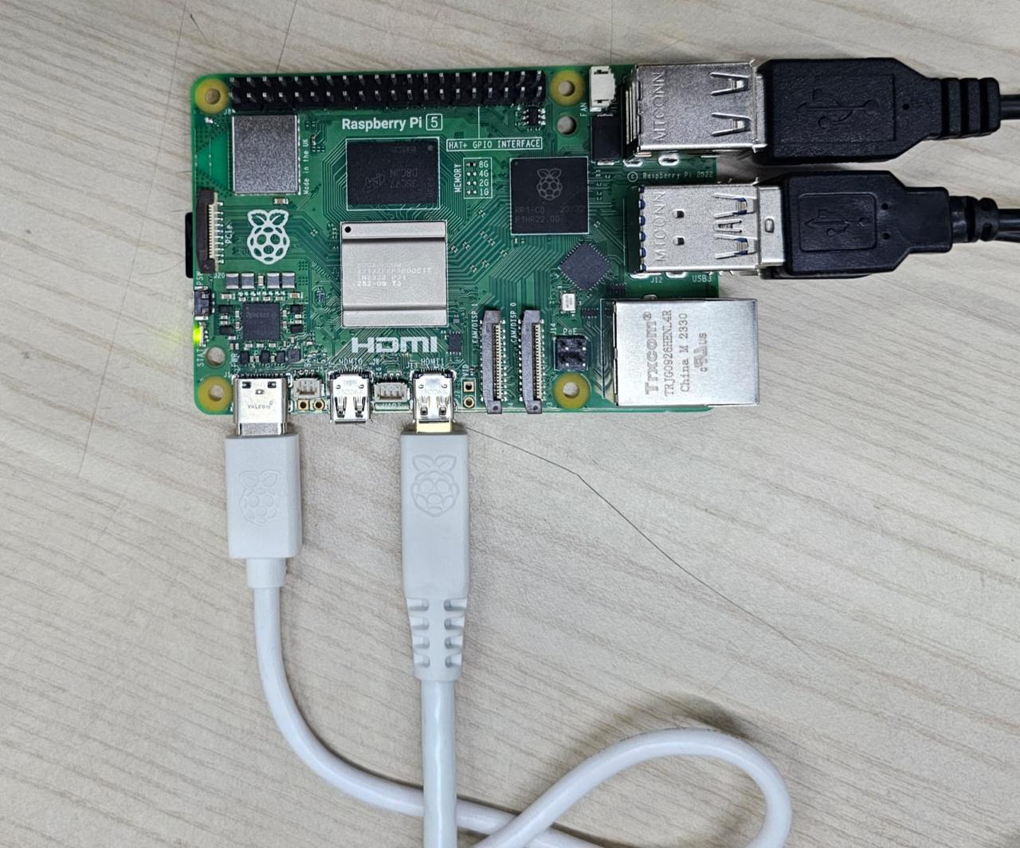



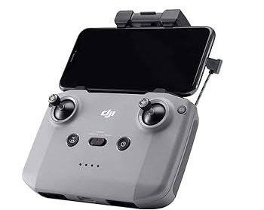
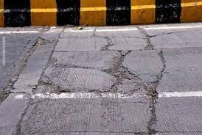
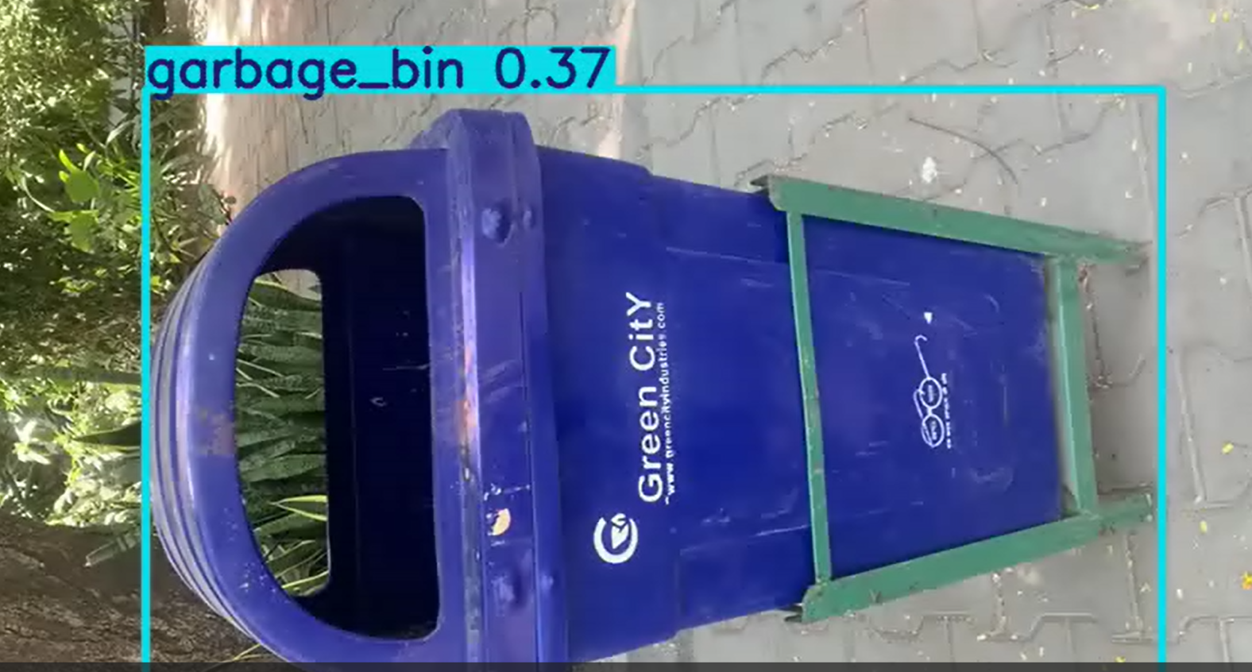
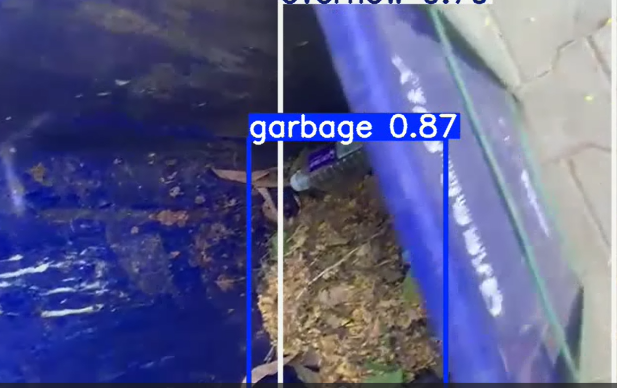
Functional Diagram
RTMP
Nvidia Raspberry Pi
4G
5G
WiFi
600x600
1.3FPS
720p HD
1MBPS
30FPS

Slide 8
Dataset Collection & Annotation
Images were captured in various environments containing garbage.
- Roboflow was used to upload, label, and augment the dataset.
- Annotations were exported in YOLOv5-compatible format for training.

Slide 9
Model Training
YOLOv5 model was trained on Google Colab using the Roboflow dataset.
- Training Parameters: 100 epochs, batch size = 16, image size = 640x640
- Evaluation: Achieved high mAP and precision for garbage detection classes.

Slide 10
Edge Deployment on Raspberry Pi
Exported the YOLOv5 model weights (.pt) to Raspberry Pi.
Installed necessary libraries: PyTorch, OpenCV, etc.
Captured frames using Pi Camera and performed real-time inference on Pi.

Slide 11
Applications & Impact
- Smart city waste monitoring and management
- Environmental cleanliness tracking
- Municipal automation for garbage collection
- Reduction in manual monitoring and increased efficiency

Slide 12
Conclusion
Successfully combined Machine Learning, Edge AI, and Drone Technology.
- Developed a real-time, efficient, and scalable garbage detection system.
- Potential to revolutionize urban cleanliness and waste management systems.

Slide 13
References
[1] Roboflow:
https://roboflow.com
- YOLOv5 GitHub:
https://github.com/ultralytics/yolov5
- Google Colab:
https://colab.research.google.com
- Raspberry Pi Documentation:
https://www.raspberrypi.org/documentation/

Slide 14
Thank You

